Slide 1


PacificERP System
A Tailored Enterprise Resource Planning & POS System for High-Volume Wholesale and Retail Groceries in San Andrés de Tumaco

Slide 2
Agenda
01
Advantages & disadvantages of a purpose-built ERP
02
General project definition
03
Workspace
04
Initial requirements specification
COSTALITO

Slide 3
Problem definition
Corner stores and family groceries usually track inventory, sales, suppliers, and informal credit by hand — in notebooks or from memory.
Our specific case: Tumaco
The family granero we studied in Tumaco, Nariño, currently relies only on a physical notebook. This creates uncertainty about real stock levels, loss of control over credit given to regular customers, and no sales history to plan restocking.
Stock losses from not knowing real inventory levels
Pricing and accounts-receivable errors
No control over expiration dates
No historical data to guide restocking decisions
COSTALITO

Slide 4
Justification, users & return on investment
Justification
Costalito serves a segment historically overlooked by traditional ERP platforms, reduces losses from poor inventory and credit control, and brings real data where the owner previously relied only on memory.
Return on investment
Time saved from not reconciling accounts by hand
Target users
Fewer losses from forgotten “fiado” balances
The store owner — manages inventory, sales, suppliers and finances
Fewer losses from expired or misplaced products
Family members who take turns attending the store
Real visibility into inventory and the credit portfolio
COSTALITO

Slide 5






Key Operational Pain Points
Informal Credit Leaks
Climate & Spoilage
Supply Chain Volatility
Informal customer credit ("fiado") tracked in physical paper notebooks causes revenue loss, unrecorded charges, and billing disputes with local families and boat operators.
Extreme humidity (>85%) and temperature spoil bulk grain and flour sacks if stock rotation (FEFO) is not strictly maintained before humidity damage occurs.
Landslides on the Pasto-Tumaco highway create unpredictable freight costs, making manual margin calculations and bulk sales pricing highly error-prone.
COSTALITO

Slide 6
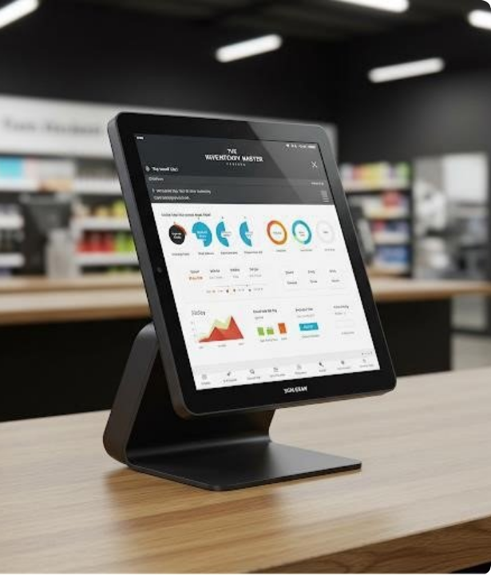
System Architecture Overview
Engineering Resilience
PacificERP is designed with an offline-first modular architecture, ensuring continuous operation during electrical or internet outages in coastal river ports.
By coupling localized transaction storage with automatic background cloud synchronization, store owners achieve 100% uptime, fast checkout speeds, and multi-tier price protection.
COSTALITO

Slide 7


Module 1: Dual-UoM & Warehouse Control
Dual Unit-of-Measure (UoM) Engine
FEFO Stock & Aging Alerts
Seamlessly accepts inventory in bulk sacks (e.g., 50kg Rice Sacks) and dynamically deducts stock whether sold as full wholesale sacks or retail pounds/kilos at the counter.
Automated alerts notify staff when dry grains or flour approach humidity risk thresholds, prioritizing stock dispatch to prevent spoilage and eliminate unrecorded shrink.
COSTALITO

Slide 8

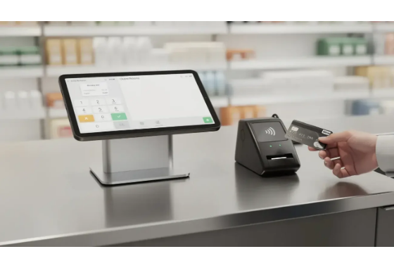
Module 2: Smart POS & Digital Credit Ledger
Touch POS Interface: Ultra-fast barcode scanning and touch lookup optimized for peak retail traffic.
Digital Credit Ledger ("Fiado"): Assigns credit limits per customer, logs cash advances, and issues digital or thermal receipts.
Automated Price Tiering: Auto-switches pricing rules between urban retail buyers and fluvial wholesale boat operators.
Dispute Elimination: Historical ledger tracking prevents billing conflicts with regular patrons and riverfront merchants.
COSTALITO

Slide 9






Modules 3 & 4: Costing & Workforce
Dynamic Freight Costing
Accounts Payable
Workforce & Shifts
Weighted average cost engine factors in freight fluctuations along the Pasto-Tumaco route to suggest profitable retail and wholesale sale prices.
Automated payment schedules for regional distributors prevent supply blackouts and avoid costly default penalties.
Tracks shift attendance, wage advances, and daily payouts for loading dock operators with strict Role-Based Access Control (RBAC).
COSTALITO

Slide 10
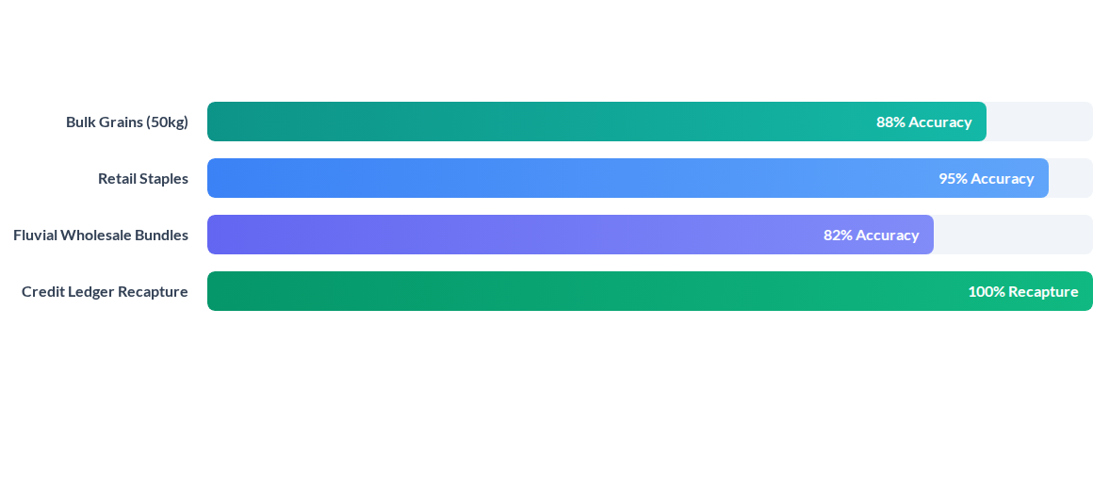
Module 5: Real-Time Profitability Analytics
COSTALITO

Slide 11
Engineering Stack Highlights
Offline-First Architecture: Uses local PWA / IndexedDB datastores with CRDT sync protocols to survive coastal connectivity outages seamlessly.
Thermal & Mobile Bluetooth Printing: Generates instantaneous hard-copy transaction slips for counter purchases and credit vouchers.
Granular Security & RBAC: Encrypts net profit metrics and cost structures, restricting sensitive reports exclusively to business owners.
Low-Bandwidth Optimization: Optimized payload compression operates smoothly over weak 3G cellular signals during network degradation.
COSTALITO

Slide 12
Proposed solution
A lightweight web application built around five modules
Inventory
Sales & billing
Suppliers
Customers & credit
Reports
Stock levels, low-stock alerts, expiration tracking
Fast checkout, digital receipts, sales history
Purchases, orders, purchase history
“Fiado” balances, payments, reminders
Best sellers, cash flow, outstanding credit
Designed so any family member can operate it — no external, technically trained staff required.
COSTALITO

Slide 13
4. Benchmark: existing solutions
Application | Cost | Inventory | Billing | CRM | Credit (“fiado”)
Siigo Nube | ~$45,000 COP/mo | Yes | Yes | Limited | No
Alegra | ~$25,000 COP/mo | Yes | Yes | Basic | No
Loyverse | Free + paid add-ons | Yes | Yes | Basic | No
Costalito | Free (academic) | Yes | Yes | Yes | Yes
Costalito’s differentiator: none of the reviewed applications explicitly support informal customer credit.
COSTALITO

Slide 14
4. Functional requirements overview
Full decomposition tree (up to 4 levels) is available in the project documentation.
1. Inventory
2. Sales
3. Suppliers
4. Customers & credit
5. Reports
Product registration
Unit / bulk sale
Supplier registration
Customer registration
Best sellers
Stock control & alerts
Billing & receipts
Order tracking
“Fiado” balance control
Cash flow
Purchases & shrink log
Cash or credit payment
Purchase history
Payment reminders
Outstanding credit
COSTALITO

Slide 15
4. Non-functional requirements, scope & technologies
Key non-functional requirements
Usability
Selected technologies
Performance
Enterprise Architect
Availability
UML modeling of the system's structural views
Security
Scalability
Visual Studio
Development environment for implementation
Compatibility with entry-level devices
GitHub + GitHub Pages
Scope (triple constraint)
Version control, collaboration and documentation site
Scope:
Inventory, sales, suppliers, customers/credit, and basic reports
Time:
Fits the academic semester, ~16 weeks
Cost:
Academic project — free / open-source tools only
COSTALITO

Slide 16
Thank you
COSTALITO — bringing simple, accessible digital tools to a family granero in Tumaco.
John Alejandro Celis · Sebastián Cabanzo · Jhunior Estiven Delgado
Questions & discussion

Slide 17


Image Sources
https://theinventorymaster.com/wp-content/uploads/2025/05/u6.jpg
Source: theinventorymaster.com
https://www.poszeo.com/wp-content/uploads/2026/03/Cash-Register-and-POS-Which-Checkout-System-Fits-Your-Business-5-1300x743.webp
Source: www.poszeo.com

